Slide 1

AL-FARABI KAZAKH NATIONAL UNIVERSITY
Department of General Linguistics and European Languages
Course name: Methods of Foreign Language Education
Name of author: Aliakbarova A.
academic degree, position: senior lecturer

Slide 2
TEACHING APPROACHES: WHAT IS THE SILENT WAY?
1. Features of the Silent Way Method.
2. Types of learning and teaching activities. The role of instructional materials.
3. Objectives of the Silent Way Method.
4. Advantages and disadvantages of the Silent way method.

Slide 3
WHAT IS THE SILENT WAY?
Silent Way originated in the early 1970s and was the brainchild of the late Caleb Gattegno.
The last line of Benjamin Franklin’s famous quote about teaching and learning can be said to lie at the heart of Silent Way.

Slide 4
The silent way (Caleb Gattegno) (1/2)
Characterized by a problem-solving approach.
Develops independence and autonomy and encourages students to cooperate with each other.
  Learning is facilitated if the learner discovers or creates rather than remembers and repeats what is to be learned.
  Learning is facilitated by accompanying (mediating) physical objects).
  Learning is facilitated by problem solving the material to be learned.

Slide 5
Typical techniques (1/3)
Sound-Colour Chart: The teacher refers students to a color-coded wall chart depicting individual sounds in the target language - students use this to point out and build words with correct pronunciation.
Teacher's Silence: Teacher is generally silent, only giving help when it is absolutely necessary.
Peer Correction: Students encouraged to help each other in a cooperative and not competitive spirit.

Slide 6
Typical techniques (2/3)
Self-correction Gestures: Teacher uses hands to indicate that something is incorrect or needs changing - e.g.. using fingers as words then touching the finger/word that is in need of correction.
Word Chart: Words are depicted on charts, the sounds in each word corresponding in colour to the Sound-Colour Chart described above - students use this to build sentences.

Slide 7
Typical techniques (3/3)
Fidel Chart: A chart that is color-coded according to the sound-colour chart but includes the various English spellings so that they can be directly related to actual sounds.

Slide 8
The three basic tenets of the approach are:
that learning is facilitated if the learner discovers rather than remembers or repeats;
that learning is aided by physical objects;
that problem-solving is central to learning.

Slide 9

Silent way method
The use of the word "silent" is also significant, as Silent Way is based on the premise that the teacher should be as silent as possible in the classroom in order to encourage the learner to produce as much language as possible.

Slide 10
Objectives of Silent way
The general objective of the Silent Way is to give beginning level students oral and aural facility in basic elements of the target language.
The general goal set for language learning is near-native fluency in the target language, and correct pronunciation and mastery of the prosodic elements of the target language are emphasized.
An immediate objective is to provide the learner with a basic practical knowledge of the grammar of the language.

Slide 11
Gattegno discusses the following kinds of objectives as appropriate for a language course at an elementary level:
- students should be able to correctly and easily answer questions about themselves, their education, their family, travel, and daily events;
- speak with a good accent; give either a written or oral description of a picture, "including the existing relationships that concern space, time and numbers";

Slide 12
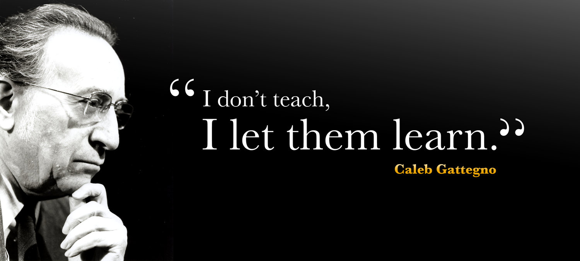
Gattegno discusses the following kinds of objectives as appropriate for a language course at an elementary level:
answer general questions about the culture and the literature of the native speakers of the target language; perform adequately in the following areas: spelling, grammar (production rather than explanation), reading comprehension, and writing.

Slide 13

The structural patterns of the target language are presented by the teacher and the grammar “rules” of the language are learnt inductively by the learners.
Cuisenaire rods (small coloured blocks of varying sizes originally intended for the teaching of mathematics) are often used to illustrate meaning.

Slide 14
New items are added sparingly by the teacher and learners take these as far as they can in their communication until the need for the next new item becomes apparent.
The learners are then left to use the new item and to incorporate it into their existing stock of language, again taking it as far as they can until the next item is needed and so on.

Slide 15
Silent way
Let us say that the teacher has introduced the idea of pronouns as in "Give me a green rod". The class will then use this structure until it is clearly assimilated, using, in addition, all the other colours.
One member of the class would now like to ask another to pass a rod to a third student but she does not know the word "her", only that it cannot be "me".
At this point the teacher would intervene and supply the new item: "Give her the green rod" and the learners will continue until the next new item is needed (probably "him").

Slide 16
The prominent writer on language teaching, Earl W. Stevick, has described the role of the teacher in Silent Way as:
"Teach, test, get out of the way".

Slide 17
Features of Silent Way
The Silent Way is characterized by its focus on discovery, creativity, problem solving and the use of accompanying materials.
1. Learning is facilitated if the learner discovers or creates.
The Silent way belongs to the tradition of teaching that favors hypothetical mode of teaching (as opposed to expository mode of teaching) in which the teacher and the learner work cooperatively to reach the educational desired goals. (cf Bruner 1966.) The learner is not a bench bound listener but an active contributor to the learning process.

Slide 18
Features of Silent Way
2. Learning is facilitated by accompanying (mediating) physical objects.
The Silent Way uses colorful charts and rods (cuisenaire rods) which are of varying length. They are used to introduce vocabulary (colors, numbers, adjectives, verbs) and syntax (tense, comparatives, plurals, word order …).
3. Learning is facilitated by problem solving involving the material to be learned.
This can be summarized by Benjamin Franklin’s words:
“Tell me and I forget
Teach me and I remember
Involve me and I learn”
A good silent way learner is a good problem solver.

Slide 19
Types of learning and teaching activities
Basic to the method are simple linguistic tasks in which the teacher models a word, phrase, or sentence and then elicits learner responses. Learners then go on create their own utterances by putting together old and new information.
Charts, rods, and other aids may be used to elicit learner responses.
Responses to commands, questions, and visual cues thus constitute the basis for classroom activities.

Slide 20
Disadvantages
– The Silent Way is often criticized of being a harsh method. The learner works in isolation and communication is lacking badly in a Silent Way classroom.
– With minimum help on the part of the teacher, the Silent Way method may put the learning itself at stake.
– The material (the rods and the charts) used in this method will certainly fail to introduce all aspects of language. Other materials will have to be introduced.

Slide 21
Advantages
– Learning through problem solving looks attractive especially because it fosters:
– creativity,
– discovery,
– increase in intelligent potency and
– long term memory.

